Slide 1




Welcome to Code Crunch!
C8|Crunch Labs: Web Dev
THU 3-4PM Weekly | Spring 2025
Attendance
Earn a Certificate of Completion by attending at least 70% of the workshops
linktr.ee/CODE.CRUNCH

Slide 2
Week #9
Mastering CSS Grid and Combining it with Flexbox for Complex Layouts

Slide 3
Introduction to the Week’s Topic
Overview: This week focuses on advanced CSS layout techniques, specifically CSS Grid and how to combine it with Flexbox for complex, responsive layouts.
Real-World Relevance:
Building modern, flexible websites requires mastering advanced layout techniques.
CSS Grid is becoming a standard for creating two-dimensional layouts, while Flexbox works best for one-dimensional layouts.
Combining both creates powerful, responsive layouts that adapt to any screen size.

Slide 4
Key Concepts for Today’s Lecture
Concepts Covered:
CSS Grid: The core concepts of the CSS Grid layout model.
Combining Flexbox and Grid: How to use both layout systems together for complex designs.
Practical Examples: Demonstrating how CSS Grid can be applied to various real-world scenarios.

Slide 5
Introduction to CSS Grid
What is CSS Grid?
CSS Grid is a two-dimensional layout system that allows you to design both rows and columns simultaneously, making it ideal for building complex, responsive grid-based layouts.
hy Use CSS Grid?
Easy alignment: Align content both horizontally and vertically with just a few properties.
Precise control: Manage the size, spacing, and placement of grid items across both axes.

Slide 6
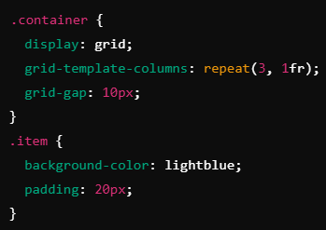

Slide 7
Core CSS Grid Concepts
Grid Container vs. Grid Items:
The container is the parent element with display: grid, and the items are the children that will be placed inside the grid.

Slide 8
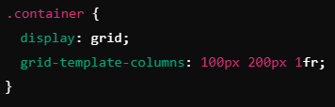
Defining Rows and Columns
You can define how many rows and columns your grid should have using grid-template-rows and grid-template-columns.

Slide 9
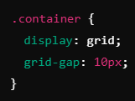
Grid Gaps
Use grid-gap to define the space between grid items:

Slide 10
Advanced Grid Features

Slide 11
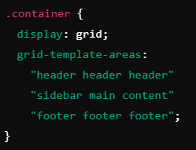
Grid Lines, Areas, and Naming:
Grid lines: These define where rows and columns start and end.
Grid areas: You can name areas in the grid to simplify placement.

Slide 12
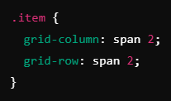
Spanning Multiple Rows/Columns
Items can span across multiple rows or columns.

Slide 13
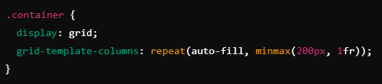
Auto-fill and Auto-f
Use auto-fill and auto-fit for responsive grid items that adjust to the screen size.

Slide 14
Combining Flexbox and CSS Grid
Why Combine Flexbox and Grid?
While CSS Grid is great for two-dimensional layouts, Flexbox excels at one-dimensional layouts. Combining both allows for complex, flexible layouts that adapt to varying screen sizes.
For instance, use CSS Grid for the overall page layout and Flexbox for the individual components inside the grid.
Real-World Example:
A two-column layout with CSS Grid, and inside each column, use Flexbox for alignment and spacing of items.

Slide 15
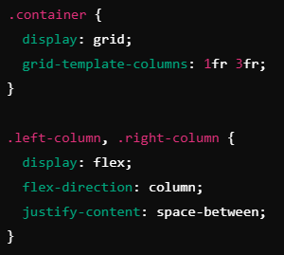

Slide 16
Practical Example: Building a Page Layout with Grid and Flexbox

Slide 17
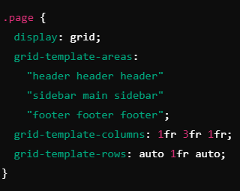
Grid for Structure:
Define the page layout with a grid, creating areas for a header, sidebar, main content, and footer.

Slide 18
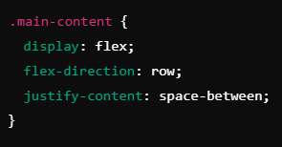
Flexbox for Content Alignment:
Inside the main content area, use Flexbox to align text, images, or cards in a row or column format.

Slide 19
Best Practices and Common Pitfalls
Best Practices:
Use CSS Grid for complex layouts with rows and columns.
Use Flexbox for simple, one-dimensional layouts within grid items.
Make use of grid areas to simplify layout placement.
Common Pitfalls:
Overcomplicating layouts: Don’t use Grid for simple, one-dimensional layouts.
Forgetting to add grid-gap to improve spacing between items.

Slide 20
Real-World Example
Case Study: An online store layout using CSS Grid for the main structure and Flexbox for individual product cards.
Grid Layout: Dividing the page into header, sidebar, content, and footer.
Flexbox Layout: Aligning product images and text descriptions within product cards.

Slide 21
Summary of Key Points
CSS Grid: Powerful for building two-dimensional layouts with fine control over rows, columns, and areas.
Flexbox: Best suited for one-dimensional layouts, aligning content in rows or columns.
Combining Grid and Flexbox: Utilize both systems together for flexible and responsive designs.

Slide 22
Coding Lab

Slide 23
Introduction to the Coding Lab
Objective: In this lab, you will create a complex layout using CSS Grid for the overall structure and Flexbox for aligning content inside grid areas.
Skills Covered:
Implementing a two-dimensional layout using CSS Grid.
Using Flexbox within grid items for alignment and spacing.

Slide 24
Task 1 - Create the Grid Structure
Step-by-Step:
Create a grid container.
Define the header, sidebar, main content, and footer using grid areas.

Slide 25
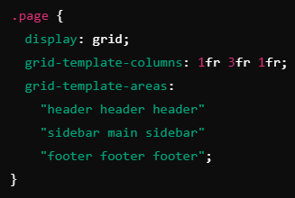

Slide 26
Task 2 - Implement Flexbox Inside Grid Items
Step-by-Step:
Inside the main content area, use Flexbox to align product items.
Align product cards horizontally using flex-direction: row.

Slide 27
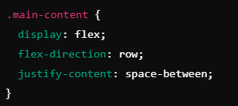

Slide 28
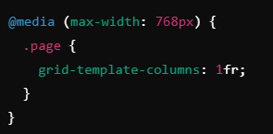
Task 3 - Add Responsive Design
Objective: Ensure the layout adjusts properly on different screen sizes.
Use media queries to change the grid layout for smaller screens.

Slide 29
Q & A Session

Slide 30

https://github.com/CODE-CRUNCH-CLUB/C8-CRUNCH-LABS-WEB-DEV

Slide 31





Attendance
Join us for the next sessions
Check our schedule on Discord “Schedule” Channel
RSVP lu.ma/CODECRUNCH
Your feedback helps us improve. Share your thoughts! Go to our website: go.fiu.edu/codecrunch
linktr.ee/CODE.CRUNCH

